Slide 1
Advance Internship@Clevered AI App/ Desktop assistant:Build your own Alexa
App User Manual
Author: Shiven Uppal

Slide 2
Table of Contents
Acknowledgement
About Me
About My Internship with Clevered
About App
How do I use the App?
Option Name
Contact Person
Thank You

Slide 3
Acknowledgements
At the outset, I would like to share my experience of the 2 week Clevered course. I started as a novice with no prior knowledge of the Python language. But I had a very smooth and fruitful journey. My mentor, Pratibha ma’am, Shivani ma’am and my support group mentors, Athira ma’am and Shilpi ma’am lent me unconditional 24x7 support. Pratibha ma’am was extremely supportive throughout my entire journey. She spent every minute of our meeting diligently explaining concepts with utmost patience. I would also like to thank my counsellor for suggesting me to go for the course. I had a challenging yet productive and a fun experience.

Slide 4
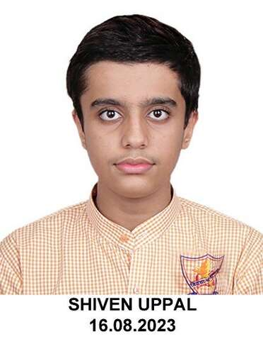
About Me..
Name: Shiven Uppal
Grade: 9
School:Sanskriti School
Enjoys: Cooking, Swimming, Participating in MUNs, learning German and spending time with friends and my dog, Leo

Slide 5
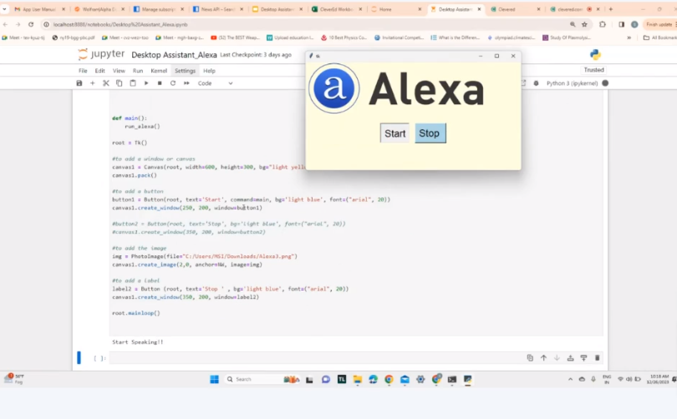
About My Internship with Clevered..
Working with Clevered was an enriching experience. My mentor really made me push boundaries, assigned small tasks during every class that made me learn beyond the scope of the project. The classes were a lot of fun. I enjoyed every minute of my sessions with Clevered

Slide 6
About App..
App’s Introduction
The app has the following features: 1 Tells the name of the App 2 Greets the Users
3 Tells the time,
4 Searches wikipedia,
5 Opens google chrome,
6 Has an inbuilt calculator,
7 Tells the top news,
8 Play a song,
9 Tells a joke
10 Tells the name of the creator
11 Closes the window on speaking STOP

Slide 7
How do I use the App?
To Start operating Alexa the user has to click on the ‘START’ button and give a command.
To stop the program and close the window the user has to say ‘STOP’.

Slide 8

Alexa - Desktop assistant

Slide 9
Alexa - Desktop assistant
Greeting/Introduction- Ask the App ‘what is your name?’ The question can’t be ‘what is’ or ‘your name’. User has to ask the complete question. App also replies ‘How are you’,‘fine’, ‘good’
Tells Time- User has to use the word ‘time’ in the question.
Searches Wikipedia- User has to say ‘wikipedia’ in command and the keywords for page that needs to be opened eg Qutub Minar, Aurangzeb etc
Opens Google- User has to use the word ‘open google’ in the question.
Calculator- User has to use the word ‘calculate’ in the question. The app may give and error when you use ‘times’ as time to calculate the time.
Speaks Top NEWS- User has to use the word ‘news’ in the question.
Plays a Song on Youtube- User has to use the word ‘play’ or ‘song’ in the question.
Tells a Joke- User has to use the word ‘joke’ in the question.
Tells about the Creator- User has to use the words ‘who made you’ or ‘who created you’ in the question.
Beyond the Scope- Incase the question doesn’t have the keywords mentioned in the above slides , Alexa will respond ‘I could not hear you properly.’
Stop- Closes the Alexa Window.

Slide 10
Contact Person
Please reach out to Shiven Uppal at shivenuppal21@gmail.com for any questions/ concerns/ suggestions on the App

Slide 11
Thank you!

